Slide 1
CSI 2020-2021 Induction Ceremony 9-9-2020

Slide 2
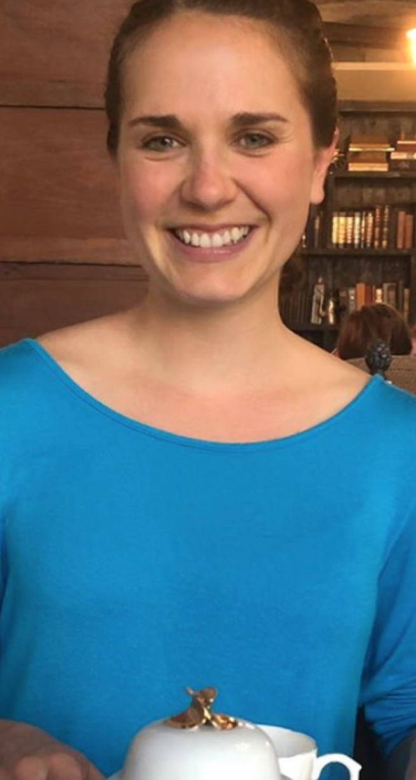
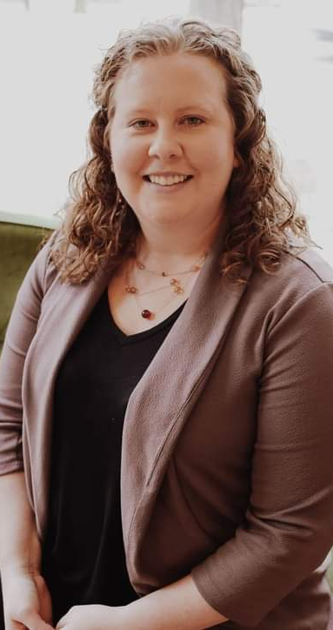
Past Committee Leaders
Michelle Kauffman
Alysha Blagg

Slide 3
Outstanding Marriage and Family Counseling Student Award Olivia Acree

Slide 4
Outstanding Clinical Mental Health Counseling Student Award Sadie Herts

Slide 5
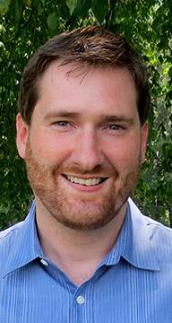
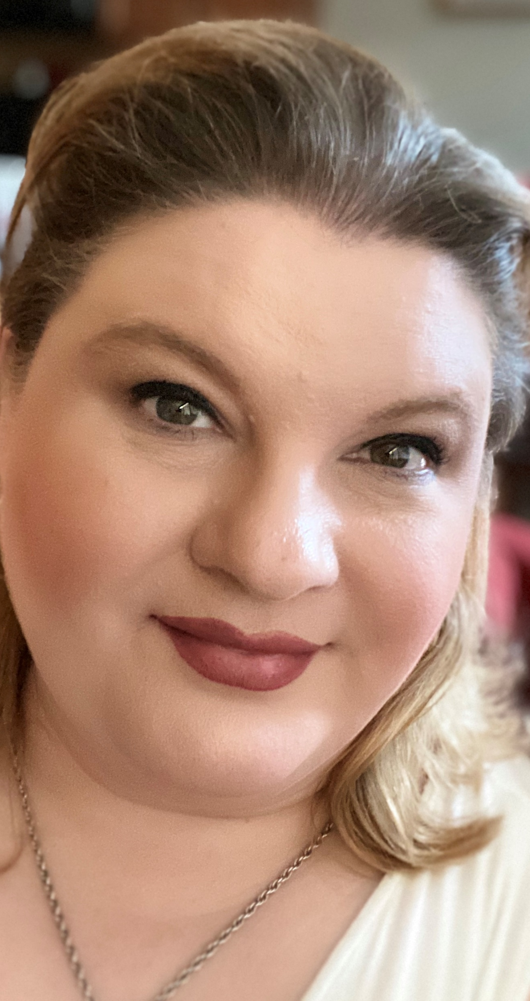
Current Membership/Mentorship Committee Leaders
Brandon Waggoner
Sheri Cobarruvias

Slide 6
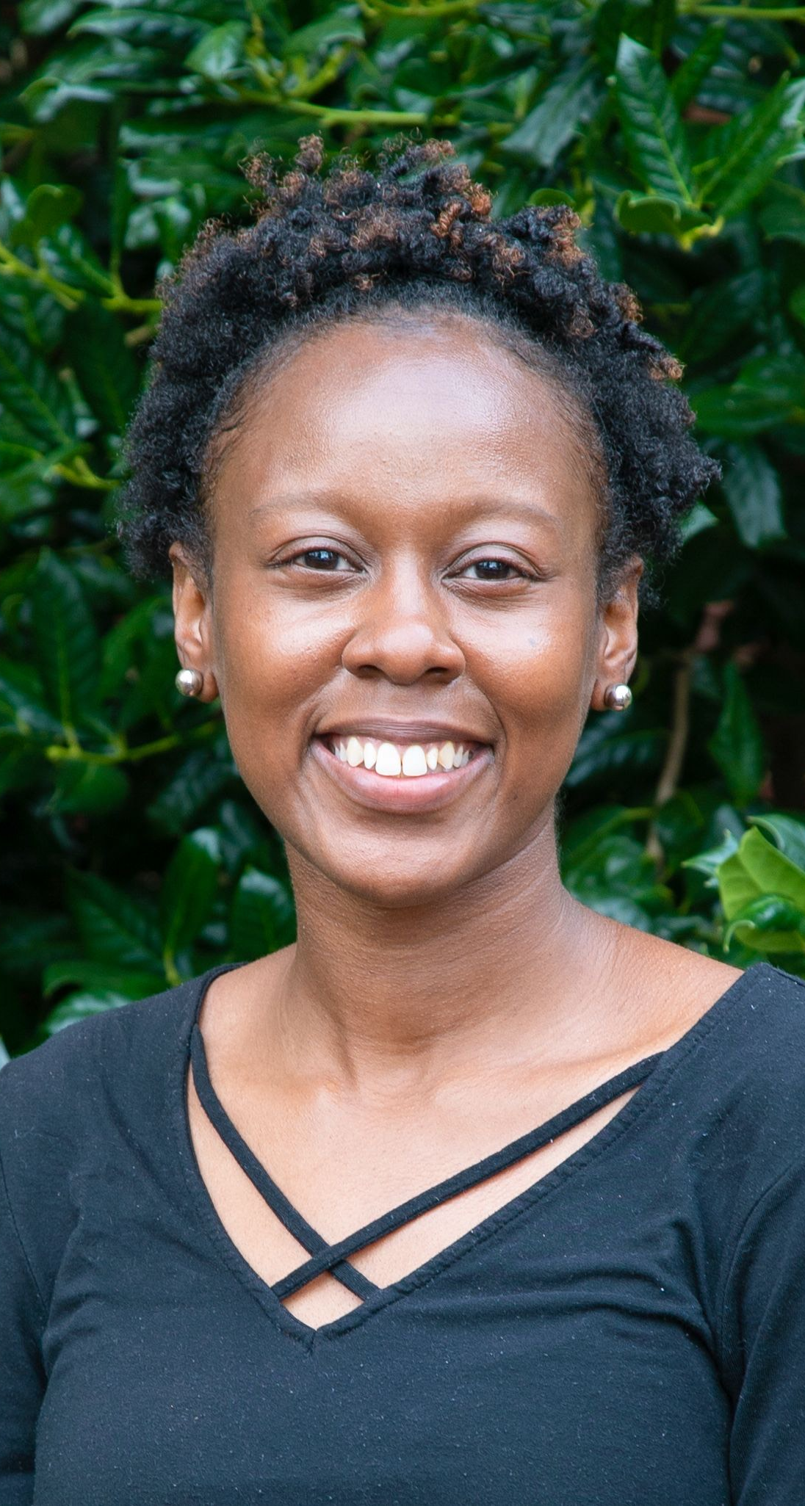
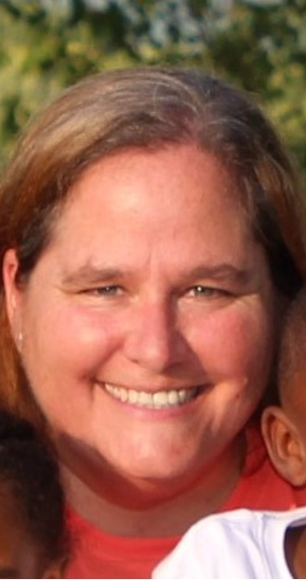
Current Events Committee Leaders
Katrina Wright
Ann Gregory

Slide 7
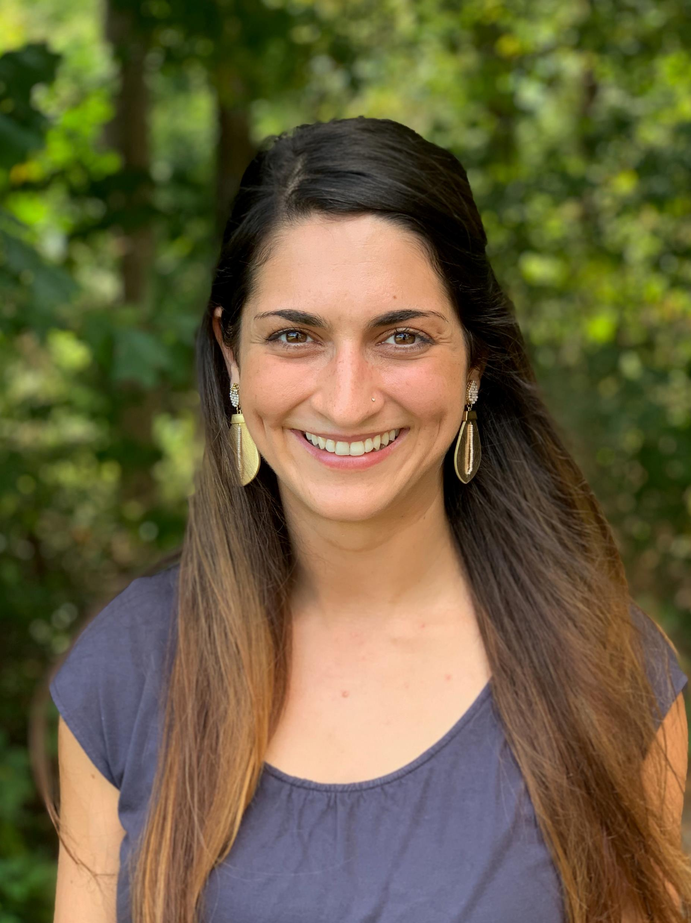
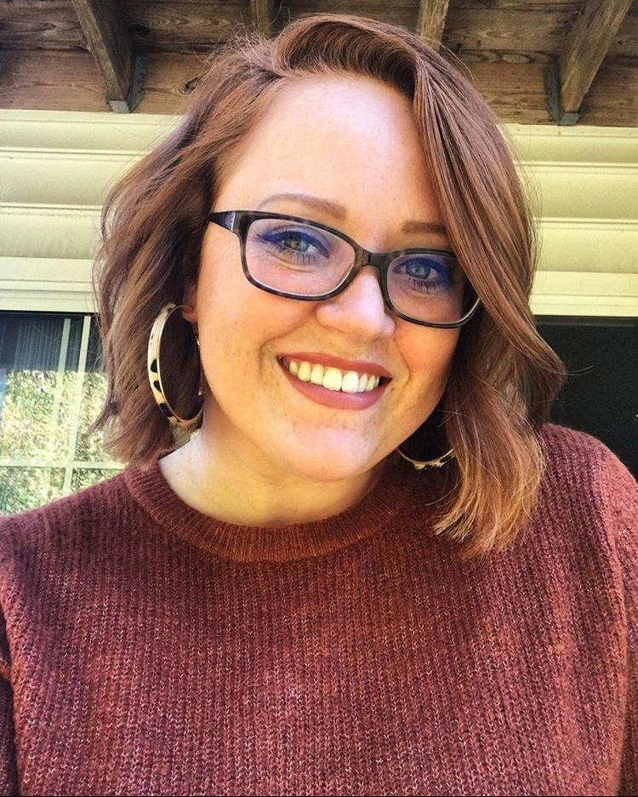
Current Secretary
Sandra Noble
Treasurer
Rachel Pierce

